Slide 1

Angular Material
Component Library

Slide 2
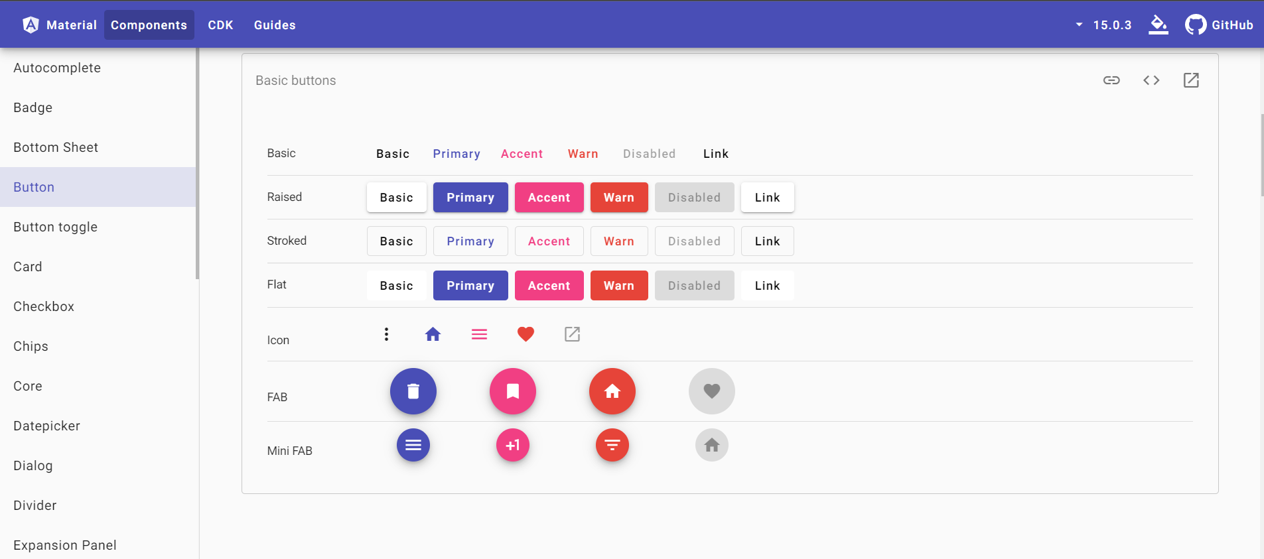
Component Library
UI Elemente
  Buttons
  Fonts
  …
Nutzung mittls NPM Dependency
Unterstützt: Konsistentes Design

Slide 3
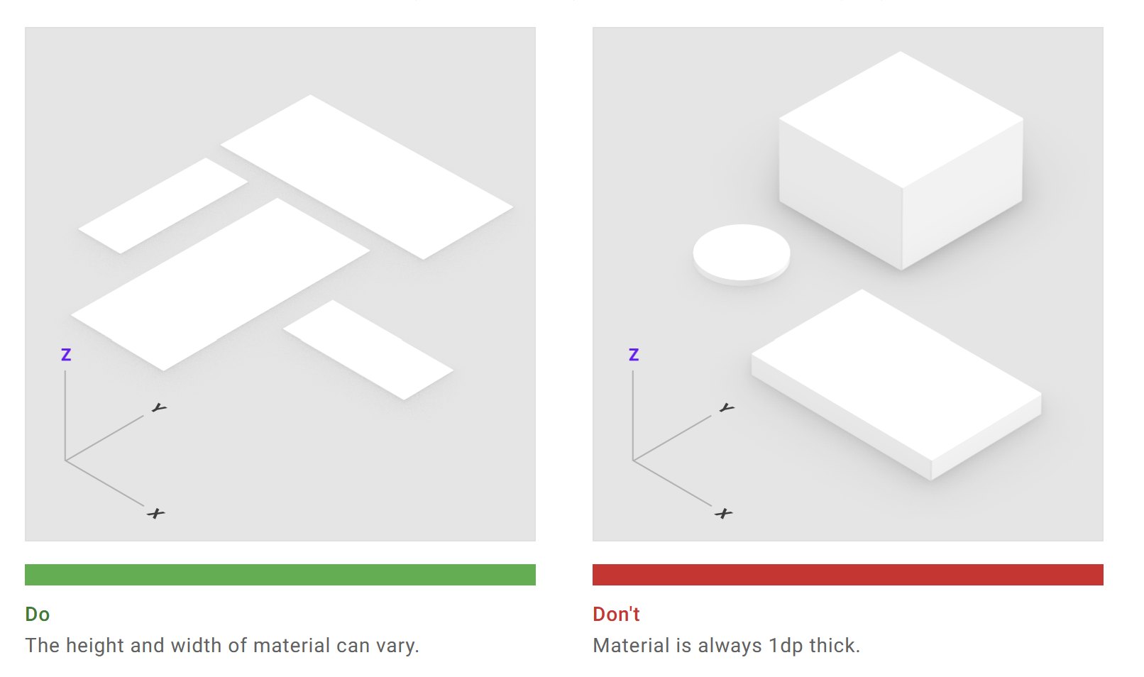
Angular Material
Google's official component library.
Standard CSS
Simple APIs mit konsistentem cross platform Verhalten
Customizable Components in Compliance der material design Specifikation.

Slide 4
Projekt Anpassungen
ng add @angular/material
i Using package manager: npm
√ Found compatible package version: @angular/material@16.2.12.
√ Package information loaded.
-…
? Choose a prebuilt theme name, or "custom" for a custom theme: Deep Purple/Amber [ Preview: https://material.angular.io?theme=deeppurple-amber ]
? Set up global Angular Material typography styles? Yes
? Include the Angular animations module? Include and enable animations
UPDATE package.json (1250 bytes)
√ Packages installed successfully.
UPDATE src/app/app.module.ts (838 bytes)
UPDATE angular.json (2929 bytes)
UPDATE src/index.html (590 bytes)
UPDATE src/styles.css (181 bytes)

Slide 5
Wichtige Anpassungen durch ng add
Index.html
<link rel="preconnect" href="https://fonts.gstatic.com">
<link href="https://fonts.googleapis.com/css2?family=Roboto:wght@300;400;500&display=swap" rel="stylesheet">
<link href="https://fonts.googleapis.com/icon?family=Material+Icons" rel="stylesheet">
angular.json
"styles": [
"@angular/material/prebuilt-themes/deeppurple-amber.css",
"src/styles.css"
],

Slide 6
Nutzung
https://material.angular.io/components/categories

Slide 7
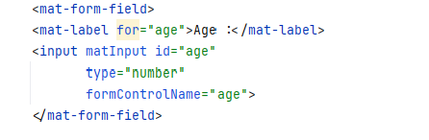
Buchungsseite mit Angular Material
BookingComponent Formular mit Material Eingabefeldern
  Training <select Element mit <option *ngFor=„let training of trainings>{{training.name}}</option>
  Datum
  Name
  Email (optional)
  Teilnehmeranzahl
→ Module Booking Module
→ BookingComponent und richte eine Route zu der Component in AppRoutingModule.ts mit Pfad „booking“ ein
→ Booking Class {id: number, trainingId: number, name: string, numberOfParticants: number} in booking.model.ts
→ BookingService → getAll(), insert() speichert in Array private bookings[]: Booking

